Slide 1


Waves
Recording sound waves and sound wave interference

Slide 2
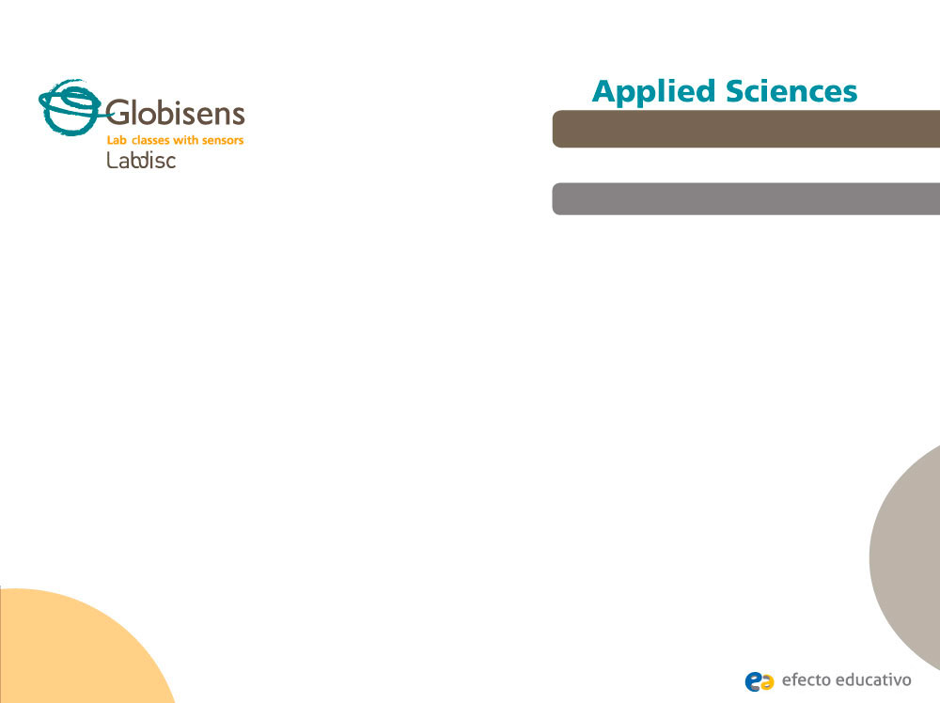
Waves
Recording sound waves and sound wave interference
^{Objective}
The purpose of this activity is to study sound waves coming from two tuning forks in order to create a hypothesis. The hypothesis will be tested by an experiment using the Labdisc microphone sensor.

Slide 3


Waves
Recording sound waves and sound wave interference
^{Introduction and theory}
The aim of the introduction is to focus students on the lesson subject by refreshing acquired knowledge and asking questions which encourage research development. Key concepts from the theoretical framework, applied by the students during the lesson, are taught.
^{Introduction}
If you gently touch the surface of a cup of water with a teaspoon you’ll notice an oscillatory movement on the water’s surface, even though the spoon only touched one point of the cup area. This happens because when the spoon contacts the water it creates a wave that propagates through the medium.
What do you know about the behavior of waves? How would you describe it?
Name examples of waves that you have noticed in your daily life.

Slide 4
Waves
Recording sound waves and sound wave interference
^{Introduction and theory}
Carry out the experiment activity with your class so that at the end you’ll be able to answer the following question:
How do waves interact with each other?

Slide 5
Waves
Recording sound waves and sound wave interference
^{Introduction and theory}
^{Theoretical}
A wave can be defined as a disturbance or variation that propagates through matters. Waves can be classified depending on the medium and on the direction they travel.
According to the medium of propagation, waves can be classified into two groups: Mechanical waves and electromagnetic waves. Mechanical waves are the ones that require a medium to propagate. For example, sound waves travel through the air or some other material. On the other hand, electromagnetic waves, like light waves, don’t need a medium to propagate, because they may travel through a vacuum (i.e., empty space).

Slide 6
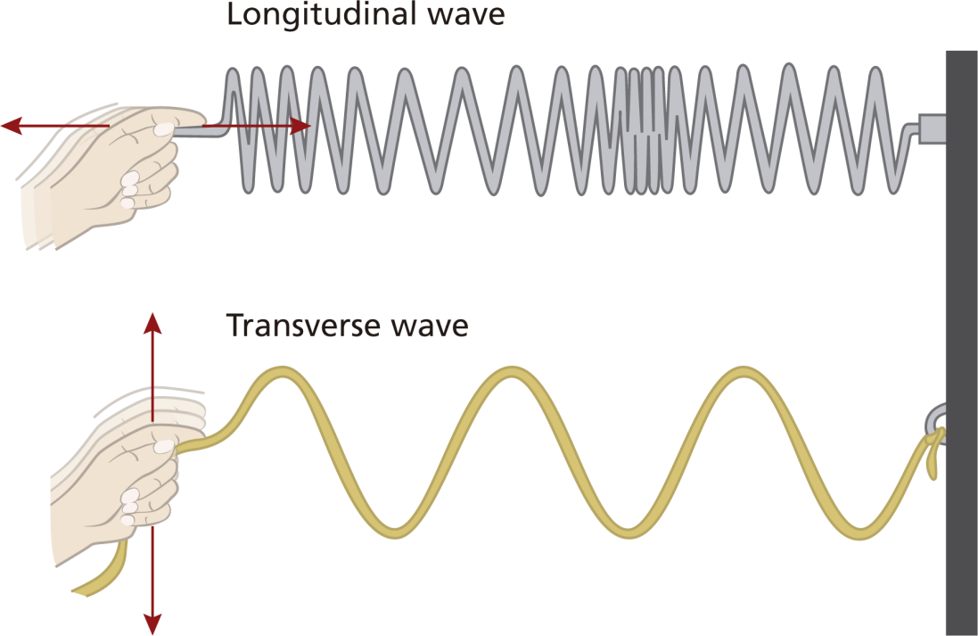
Waves
Recording sound waves and sound wave interference
^{Introduction and theory}
Waves can be categorized into two groups depending on the direction of their propagation in space: Longitudinal waves and transverse waves. In longitudinal waves the particles of the medium oscillate in a direction parallel to that of the wave’s movement. In a transverse wave the oscillation moves in a direction perpendicular to that of the wave’s movement.
Longitudinal

Slide 7
Waves
Recording sound waves and sound wave interference
^{Introduction and theory}
Below are key scientific terms that relate to waves:
Wave train (or wave packet): Series of waves travelling in the same direction and spaced at regular intervals, like a wagon train.
Node: Region where the disturbance of the wave is almost zero (point of minimum vibration).
Amplitude (A): Usually this term refers simply to the maximum positive displacement from the rest position.
Crest: Point of the wave that exhibits the maximum amount of positive or upward displacement from the equilibrium position.
Trough: Point of the wave that exhibits the maximum amount of negative or downward displacement from the rest position.
Period (T): Time it takes for a wave to complete a single cycle, measured in unit seconds.

Slide 8

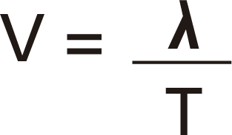
Waves
Recording sound waves and sound wave interference
^{Introduction and theory}
Frequency (f): Equal to the reciprocal of the period, frequency refers to how many waves are made per time interval (usually per second) and measured in unit Hertz (Hz).
Wave length ( ): Distance between any two adjacent corresponding points on the wave train.
Speed of a wave (v): Distance ( ) traveled by a given point on the wave in a given interval of time (T).
In equation form:

Slide 9
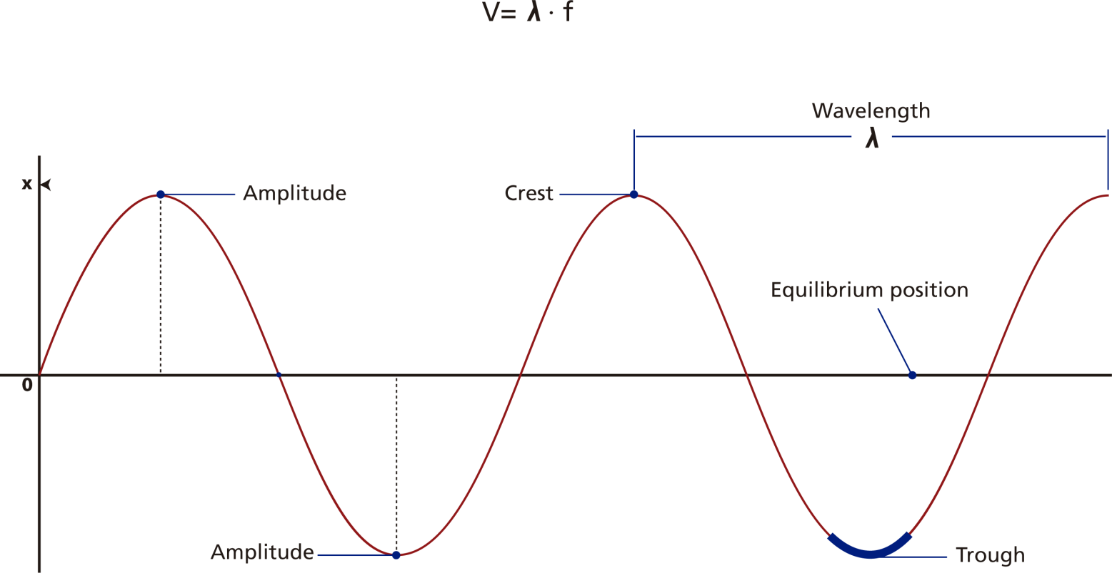
Waves
Recording sound waves and sound wave interference
^{Introduction and theory}
If you remember that period and frequency are reciprocal to each other, you can easily obtain the following expression:

Slide 10
Waves
Recording sound waves and sound wave interference
^{Introduction and theory}
When there is more than one wave in the same space and time interferences can occur which may be constructive or destructive.
Constructive interference occurs when two waves are superimposed on each other as an addition, either crest over crest or trough over trough. In this case, the final wave has greater amplitude than the original waves, because the amplitude of both is added.
On the other hand, destructive interference occurs when the crest of one wave meets the trough of the other. In this case, the final wave has smaller amplitude because a positive altitude is summed to a negative altitude, in other words this addition looks like a subtraction.
As we mentioned before, sound is a form of mechanical wave caused by the vibration of a body. Sound travels in space as longitudinal waves, causing a back and forth oscillation of the particles of the medium. Since this oscillation causes temporal changes in air density, high-pressure and low-pressure regions are formed, related to the maximum distance of the particle movement (amplitude).

Slide 11
Waves
Recording sound waves and sound wave interference
^{Introduction and theory}
Therefore, sounds are classified as loud or weak depending on the magnitude of amplitude, referring to the sound intensity. Sound intensity is defined as the amount of acoustic energy that is transported past a given area of the medium per unit time (second).
Acoustic energy depends on acoustic power. Wave amplitude and acoustic power are directly proportional to each other, i.e. the higher the altitude the greater the acoustic power. You can conclude accordingly that wave amplitude and sound wave intensity are directly proportional. For this reason, we will use sound wave intensity in unit decibels (dB) as equal to amplitude, even if we know them to be different concepts.
Now students are encouraged to raise a hypothesis which must be tested with
an experiment.
Let’s record a sound wave. How do you think a sound wave will look?
Do you think that two waves of a similar nature, coming from two different sound
sources, will interact with each other?

Slide 12
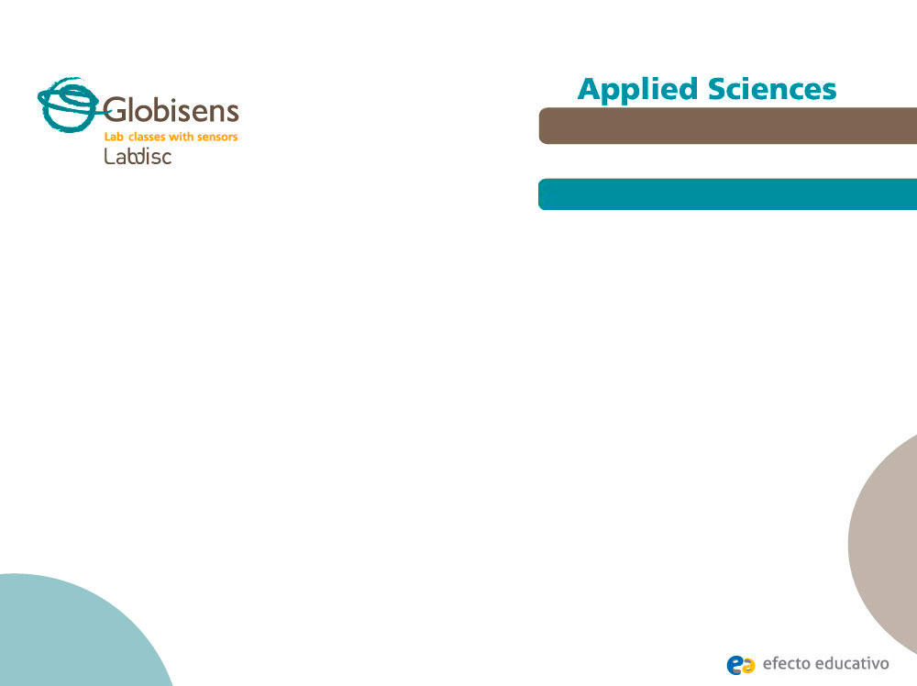
Waves
Recording sound waves and sound wave interference
^{Activity description}
Students will measure the sound wave by placing the Labdisc microphone near one tuning fork A440 (f=440Hz). Then they will use another tuning fork at a slightly different frequency, record both tuning forks at the same time and analyze the sound wave interference.

Slide 13
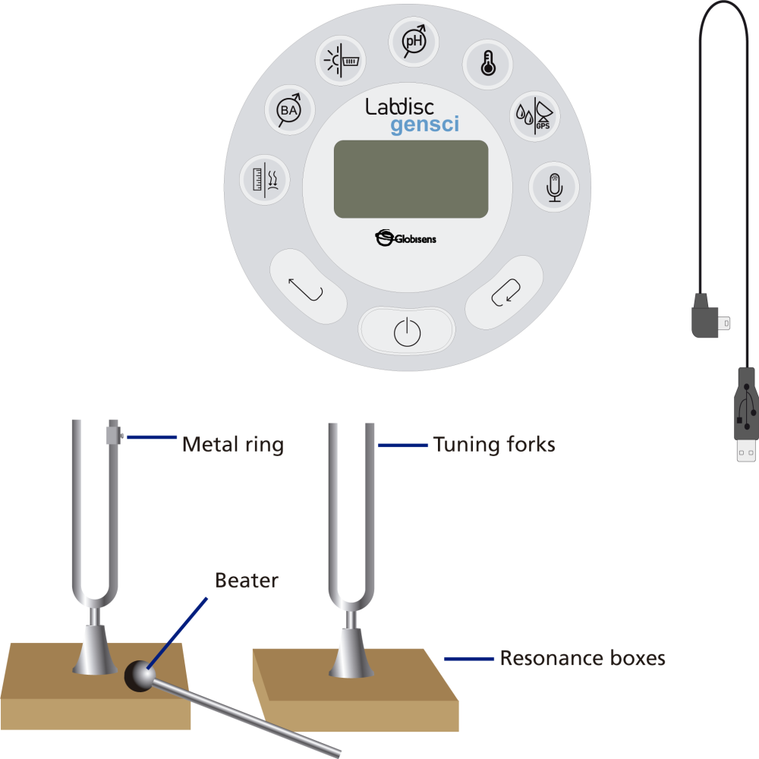
Waves
Recording sound waves and sound wave interference
^{Resources and materials}
Labdisc
USB connector cable
Labdisc holder
2 tuning forks A440
1 metal ring for changing tuning fork frequency
2 resonance boxes
1 beater

Slide 14

Waves
Recording sound waves and sound wave interference
^{Using the Labdisc}
^{a. Using the Labdisc}
To collect measurements with the microphone sensor, the Labdisc must be set up according to the following steps:
Turn on the Labdisc by pressing
Open the GlobiLab program.
To perform this activity we recommend using wireless communication. If your computer does not support Bluetooth, you may use USB connection. Please refer to the Quick Start Guide, supplied with the Labdisc for instructions on how to set Bluetooth communication and pair your device with the computer.

Slide 15


Waves
Recording sound waves and sound wave interference
^{Using the Labdisc}
When using the Bluetooth communication: Right click on the Bluetooth icon in the bottom right corner of the GlobiLab’s screen and select the Labdisc you are using. The icon will change from grey to blue, indicating that the Labdisc and the computer are now connected via Bluetooth communication.
When using the USB communication: Connect the Labdisc and the computer with the USB cable supplied with the Labdisc. Click on the USB icon in the bottom right corner of the GlobiLab screen. The icon will turn blue, indicating that the Labdisc is connected to the computer via USB.

Slide 16

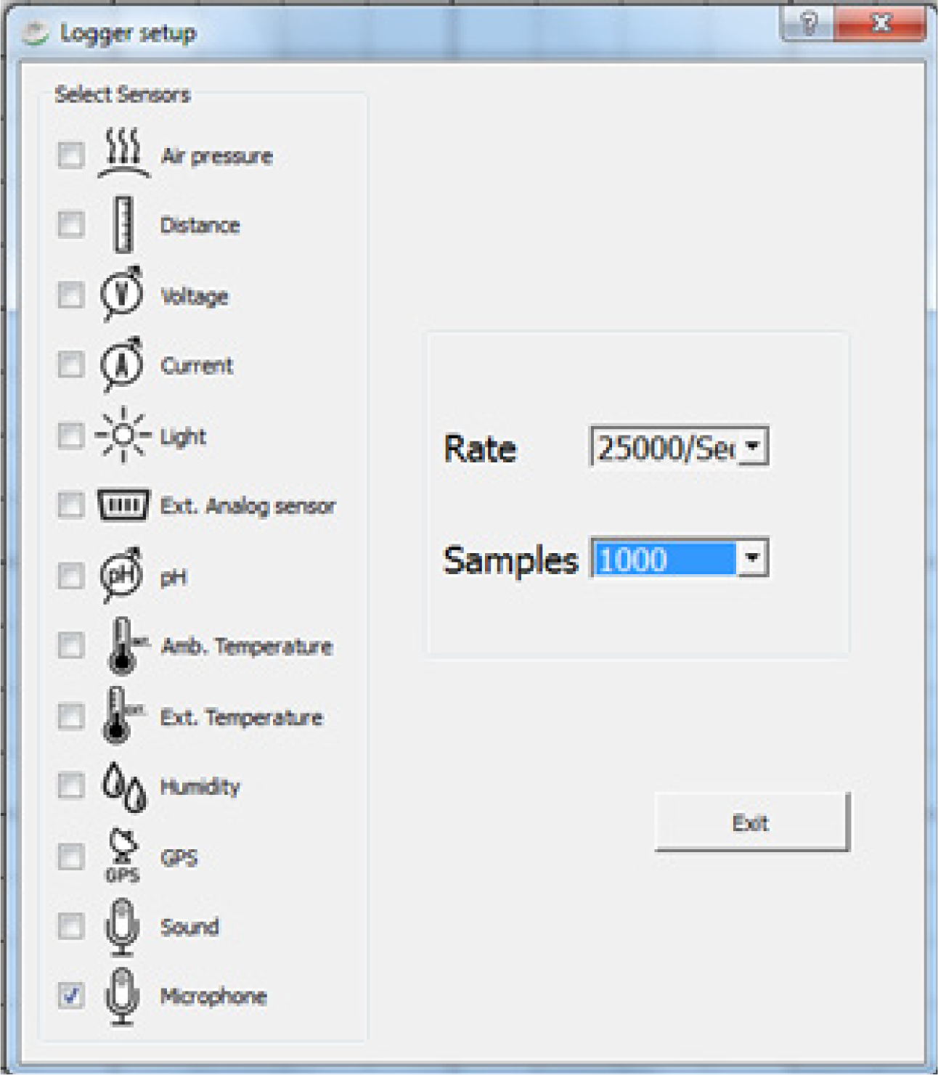
Waves
Recording sound waves and sound wave interference
^{Using the Labdisc}
Click on the button to configure the Labdisc. On the “Logger setup” window select microphone sensor, -25000/sec- in “rate” and - 1000 - “samples”.

Slide 17
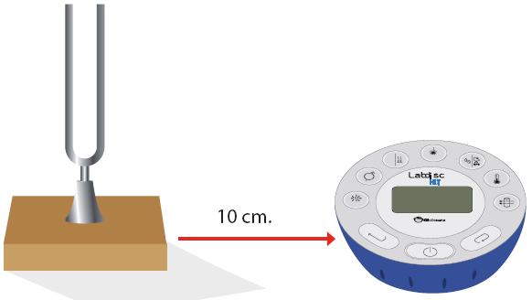
Waves
Recording sound waves and sound wave interference
^{Experiment 1}
The following steps explain how to perform the experiment:
We will first record one tuning fork.
Insert the tuning fork into the resonance box.
Place the Labdisc about 10 centimeters away from the resonance box.

Slide 18
Waves
Recording sound waves and sound wave interference
^{Experiment 1}
Hit the tuning fork with the beater and wait 1 to 2 seconds for the sound to stabilize.
Press the RUN icon in the GlobiLab software.
The Labdisc will record 1000 samples in less than a second and then automatically upload all samples to the GlobiLab software.

Slide 19




Waves
Recording sound waves and sound wave interference
^{Results and analysis}
The following steps explain how to analyze the experiment results:
If the the Labdisc sample did not upload automatically, press the download button
Observe the graph displayed on the screen.
Click the button to zoom in on a section of the graph.
Press the button and write notes on the graph specifying the maximum and minimum amplitude value.
Press to select two points on the graph, representing the beginning and end of a single oscillation. Use the time values provided to calculate the period and frequency of the selected wave.

Slide 20

Waves
Recording sound waves and sound wave interference
^{Results and analysis}
What does a sound wave look like?
Which frequency did you obtain?

Slide 21
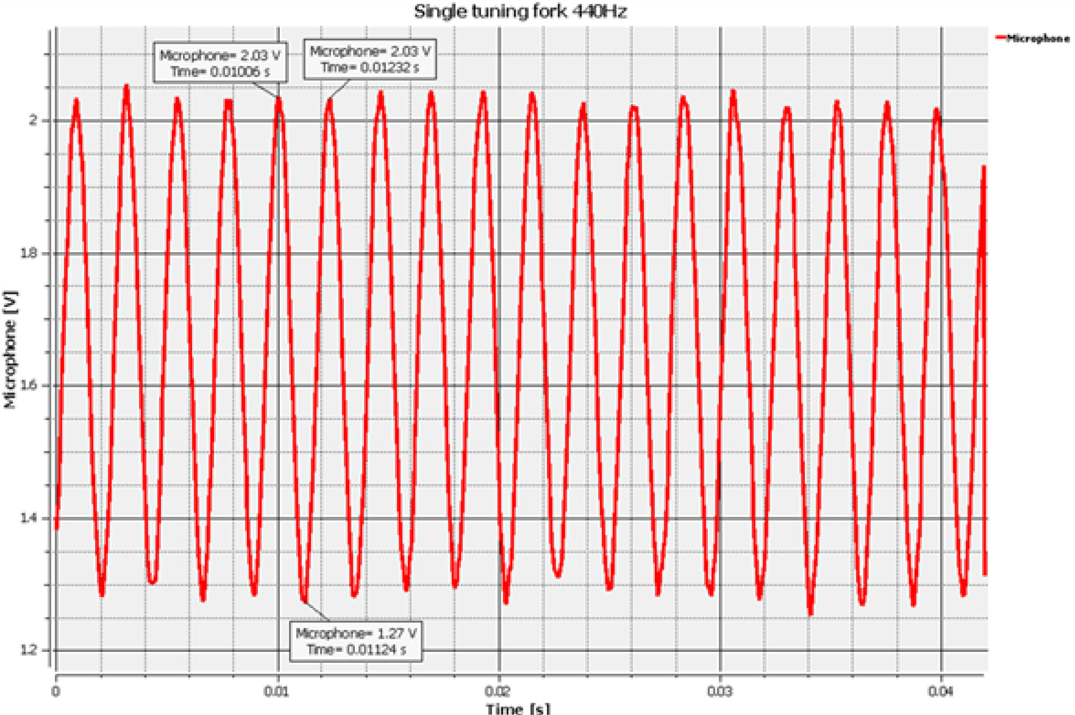
Waves
Recording sound waves and sound wave interference
^{Results and analysis}
The graph below should be similar to the one the students came up with.

Slide 22
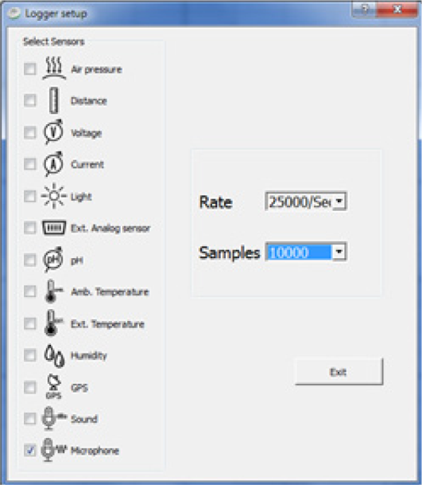
Waves
Recording sound waves and sound wave interference
^{Experiment 2}
The following steps explain how to perform the experiment:
In this experiment we will record two tuning forks at slightly different frequencies.
Use the previous Labdisc SETUP while changing the number of samples to 10,000. See the SETUP screen below.

Slide 23
Waves
Recording sound waves and sound wave interference
^{Experiment 2}
Insert the 2nd tuning fork into the 2nd resonance box.
Secure the tuning fork metal ring in the center of the 2nd tuning fork (this will slightly change it´s frequency).
Place the tuning forks 20 centimeters away from each other, where both resonance boxes are open and facing each other.
Place the Labdisc microphone in the center between the tuning forks.
Hit both tuning forks with the beater and wait 1 to 2 seconds for the sound to stabilize.
Press the RUN icon in the GlobiLab software.
The Labdisc will record 10000 samples in less than a second and then automatically upload all samples to the GlobiLab software.

Slide 24
Waves
Recording sound waves and sound wave interference
^{Results and analysis}
The following steps explain how to analyze the experiment results:
If the Labdisc sample did not upload automatically, press the download button
Observe the graph displayed on the screen.
Click the button to zoom in on a section of the graph.
Press the button and write notes on the graph specifying the maximum and minimum amplitude values.
Press to select two points on the graph, representing the beginning and end of a single oscillation. Use the time values provided to calculate the period and frequency of the selected wave.

Slide 25
Waves
Recording sound waves and sound wave interference
^{Results and analysis}
How do your results relate to your original hypothesis?
Where would you mark maximum amplitude and minimum amplitude?
Where would you mark constructive interference and destructive interference?

Slide 26
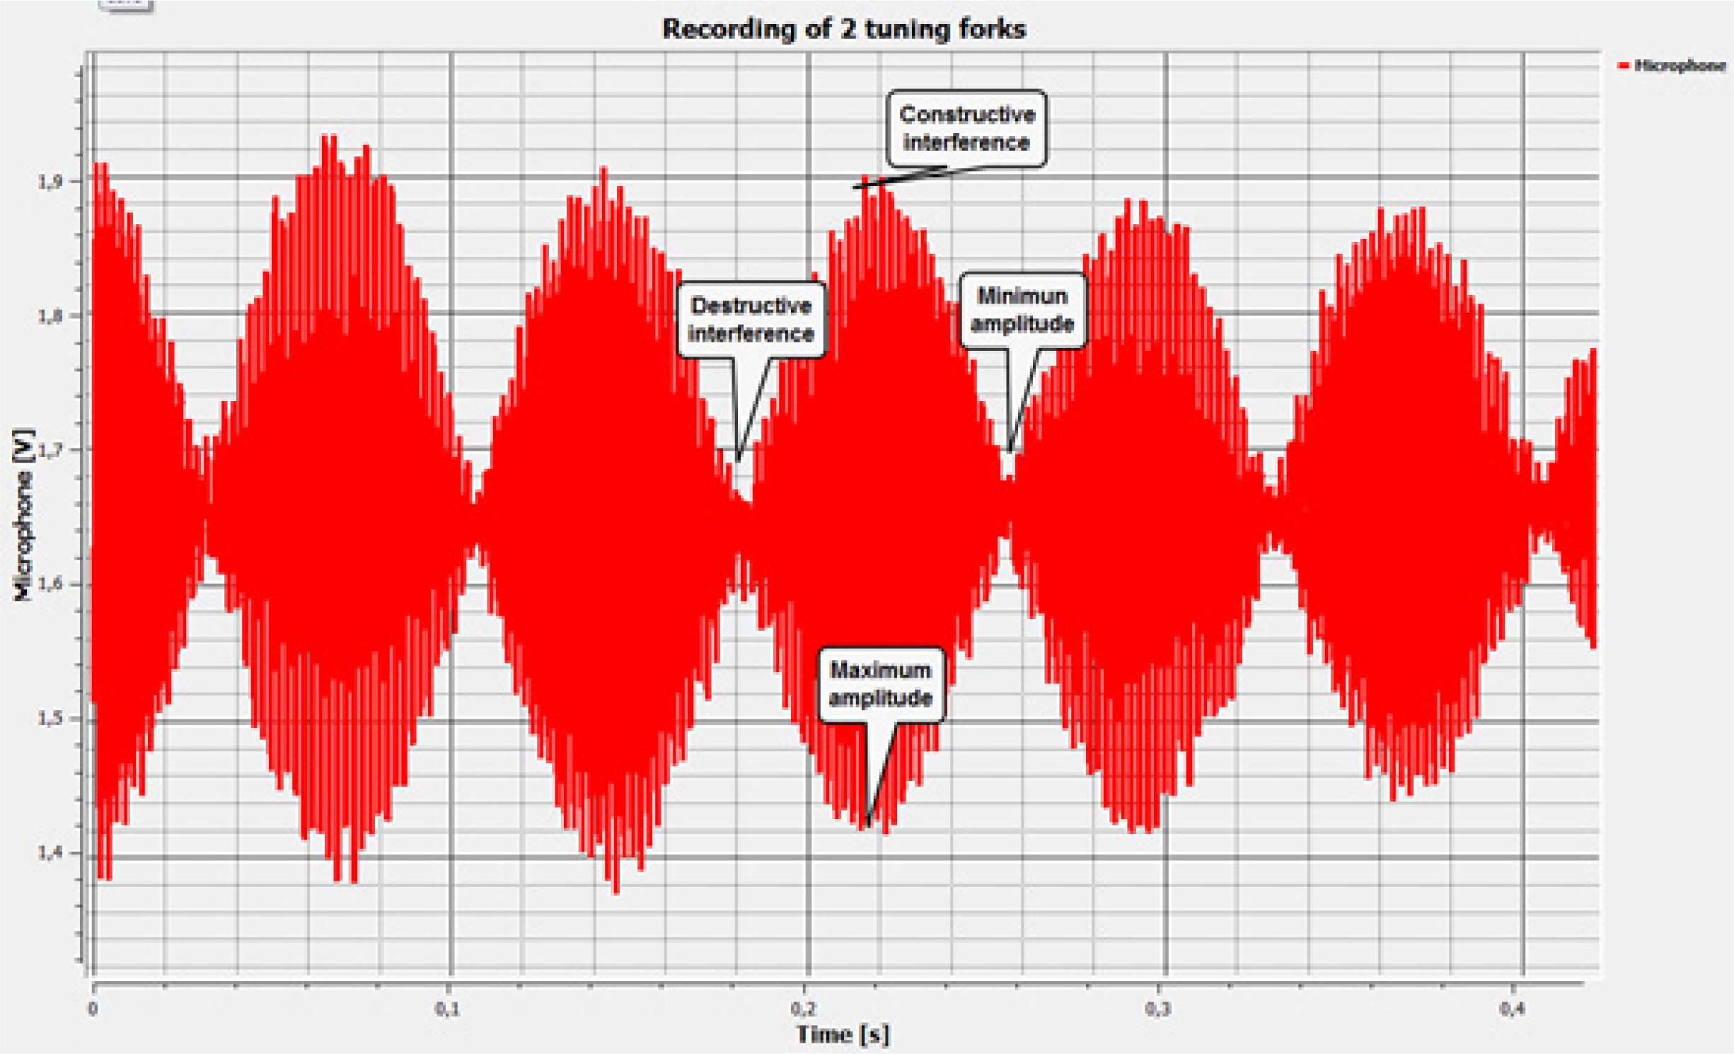
Waves
Recording sound waves and sound wave interference
^{Results and analysis}
The graph below should be similar to the one the students came up with.

Slide 27

Waves
Recording sound waves and sound wave interference
^{Conclusions}
Following are some questions and answers which should be developed by students in order to elaborate on their conclusions.
What is a wave?
Students should explore the concepts in the theoretical background, explaining that a wave is a perturbation of the medium that travels from its source in all directions.
Describe a sound wave mentioning the medium and the propagation direction.
Students should indicate that, relating the medium of propagation, sound waves are mechanical waves. According to the propagation direction, we can categorize them as longitudinal waves.

Slide 28
Waves
Recording sound waves and sound wave interference
^{Conclusions}
According to the graph, what kinds of interferences did you record? Why did these interferences appear?
Students should analyze the graph and observe the wave amplitude variation in time. They should
establish that the amplitude increases and decreases alternatively, concluding that the experiment
registered both constructive and destructive interference. Constructive interference occurred
because the crest of one wave superimposed over the crest of the other. The destructive
interference was the product of a wave trough superimposing over the crest of another.
Which of the concepts mentioned in the theoretical background can be obtained
from the graph?
Students should understand the concepts mentioned in the theoretical background. They should
use the graph to obtain the necessary parameters to calculate its values. As the y axis on the graph displays sound wave intensity and the x axis displays time in seconds, students should be able to
obtain several characteristics such as amplitude, trough, crest, period and frequency.

Slide 29

Waves
Recording sound waves and sound wave interference
^{Conclusions}
Students should reach the following conclusions:
We can describe the “anatomy of waves” by naming the parts of it, for example: wave train, node, amplitude, period and wavelength. Besides the direct information that may be extrapolated from a graph, we can also calculate some parameters indirectly. In this way we can obtain frequency and speed of propagation.
When there is more than one wave in the same space and time, interferences can occur which may be constructive or destructive. Constructive interference occurs when two waves are superimposed on each other as an addition, either crest over crest or trough over trough. In this case, the final wave has greater amplitude than the original waves, because the amplitude of both is added. Both types of interference were observed during the experiment.

Slide 30

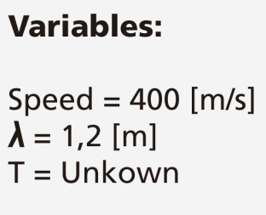
Waves
Recording sound waves and sound wave interference
Activities for further application
The aim of this section is for students to extrapolate the acquired knowledge during this class through its application in different contexts and situations. Furthermore, it is intended that students question and present possible explanations to the experimentally observed phenomena.
Further questions:
If the speed of a wave’s propagation is 400 m/s and its wavelength is 1.2 m, calculate the wave period.
Students should use the concepts explored during the class to answer this physics problem. They should extract the variables needed to solve the problem and identify correctly the unknown factor. Following is the problem’s solution:

Slide 31
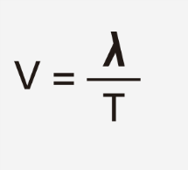
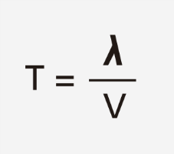
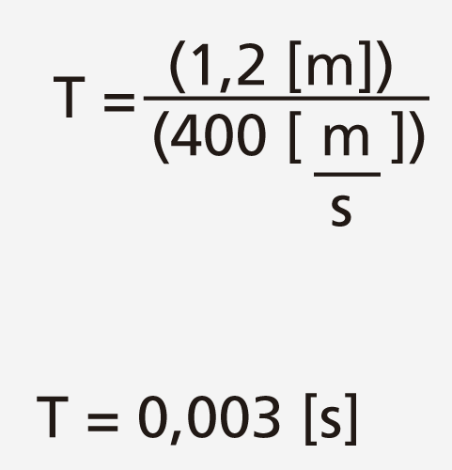
Waves
Recording sound waves and sound wave interference
Activities for further application
Solution:
If you remember:
You can rearrange the expression to become:
Using the data of the problem statement you can obtain the value of the unknown factor:

Slide 32

Waves
Recording sound waves and sound wave interference
Activities for further application
Match the concepts on the left to the corresponding statement on the right.
Frequency
Mechanical wave
Can travel through empty space (vacuumed)
Crest
Distance between two consecutive crests or troughs
Wave
Electromagnetic wave
Amplitude
Its unit of measurement is Hertz
Wave train
Packets of waves moving together
Needs matter to propagate
Speed of propagation
Highest point of a wave
Electromagnetic wave
Maximum distance of a wave from the equilibrium point
Wavelength
Sound wave
Longitudinal wave
Perturbation that travels through space
Transversal wave

Slide 33
Waves
Recording sound waves and sound wave interference
Activities for further application
Students should apply their knowledge and obtain following matches:
=
=
=
=
=
=
=
=
=
=
=

Slide 34
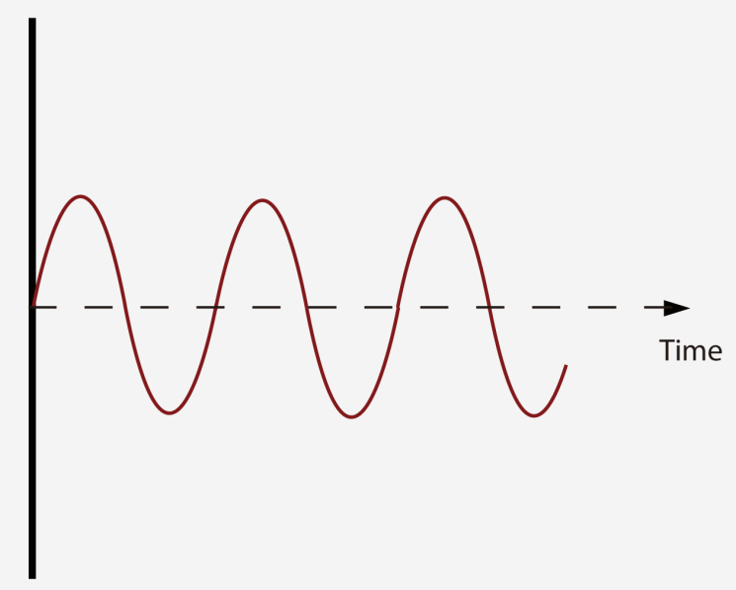
Waves
Recording sound waves and sound wave interference
Activities for further application
Find and write down the following concepts in the figure: Wave train, amplitude, trough, node, equilibrium line and wavelength.
Students should label the figure characterizing the wave with the concepts they have learned during the class. They should obtain an image similar to the one presented in the theoretical background.

Slide 35


