Slide 1

Liquid Conductivity
Measuring conductivity in saline water solutions

Slide 2
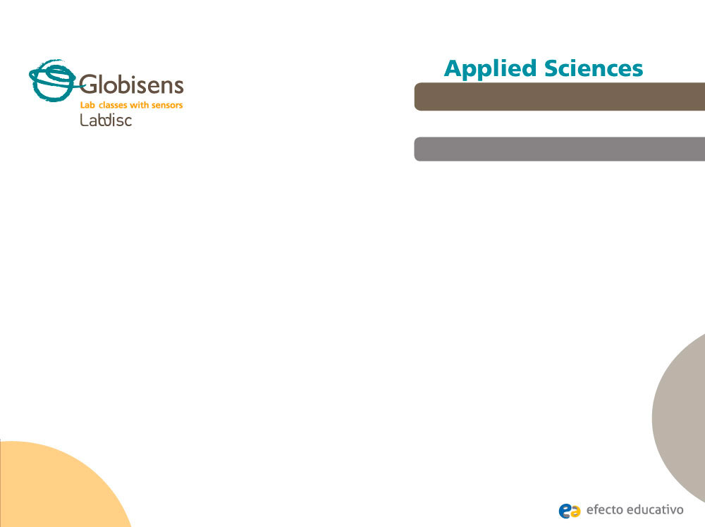
Liquid Conductivity
Measuring conductivity in saline water solutions
^{Objective}
The purpose of this activity is to study the relationship between dissolved ions and the conductivity of a saline water solution, determine and interpret the molar conductivity, create a hypothesis and proceed to test it using the Labdisc conductivity sensor.

Slide 3
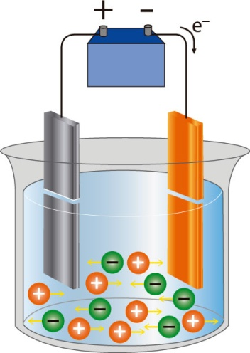
Liquid Conductivity
Measuring conductivity in saline water solutions
^{Introduction and theory}
An aqueous medium is necessary from both an organic and inorganic viewpoint. We approach this aspect of nature through the study of solutions which have different characteristics in terms of their components. In particular, the electrolytic solutions have moving dissolved ions which are capable of conducting electric current in the presence of electric potential.

Slide 4

Liquid Conductivity
Measuring conductivity in saline water solutions
^{Introduction and theory}
Do you know some examples of conductive solutions?
Could you suggest some advantages and disadvantages of this kind of solution?
Carry out the experiment activity with your class so that at the end you’ll be able to answer the following question:
What directly determines the conductivity of a solution?

Slide 5

Liquid Conductivity
Measuring conductivity in saline water solutions
^{Introduction and theory}
^{Theoretical}
In ionic solutions it is important to know how easily the electric current passes i.e. conductivity. The conductivity depends on the solute’s features, and on the concentration of dissolved ions which are responsible for the electric flux. Strong electrolytes are solutes that completely dissociate in a solution (HCl, NaCl, KOH) and show the general relation for electrolytes:
c Λ = k
Λ: Molar conductivity [mS cm⁻¹ M⁻¹]
k: Conductivity [mS cm⁻¹]
c: Concentration [mol/L or M]
The molar conductivity is the proportion between the solution conductivity and its concentration.

Slide 6

Liquid Conductivity
Measuring conductivity in saline water solutions
^{Introduction and theory}
Now students are encouraged to raise a hypothesis which must be tested with an experiment.
How are the solution concentration and conductivity related?

Slide 7
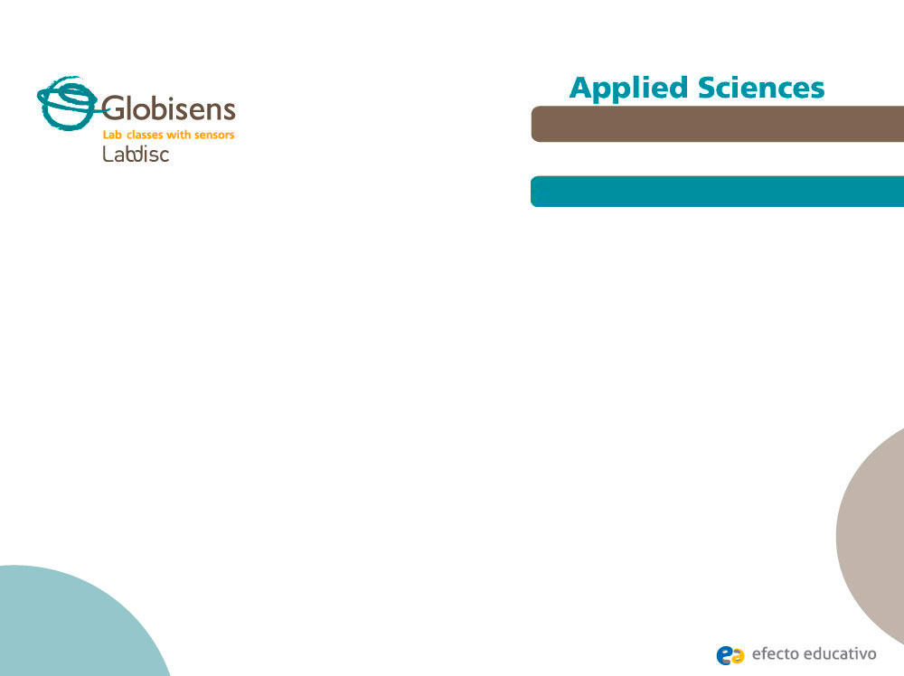
Liquid Conductivity
Measuring conductivity in saline water solutions
^{Activity description}
Students measure the conductivity of a solution of distilled water with varying amounts of NaCl and will use GlobiLab software to visualize their results and carry out a preliminary analysis. They will also calculate molar conductivity of this solution and then construct a scatter plot using the EXCEL tools.

Slide 8
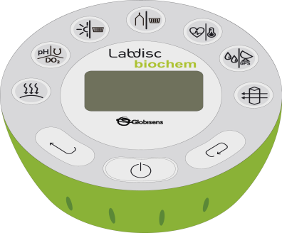
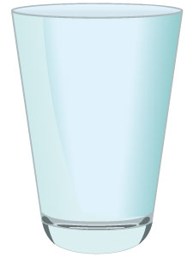

Liquid Conductivity
Measuring conductivity in saline water solutions
^{Resources and materials}
1
Labdisc Biochem
Beaker (500 ml)
Conductivity electrode
Stirrer bar
Distilled water
Salt
1
4
2
2
3
4
5
6
3

Slide 9
Liquid Conductivity
Measuring conductivity in saline water solutions
^{Using the Labdisc}
^{Labdisc configuration}
To collect measurements with the Labdisc and conductivity electrode, the Labdisc must be configured according to the following steps:
Open the GlobiLab software and turn on the Labdisc
Click on the Bluetooth icon in the bottom right corner of the GlobiLab screen. Select the Labdisc you are currently using. Once the Labdisc has been recognized by the software, the icon will change from a grey to blue color . If you prefer a USB connection follow the previous instruction clicking on the USB icon. You will see the same color change when the Labdisc is recognized .
1
2

Slide 10
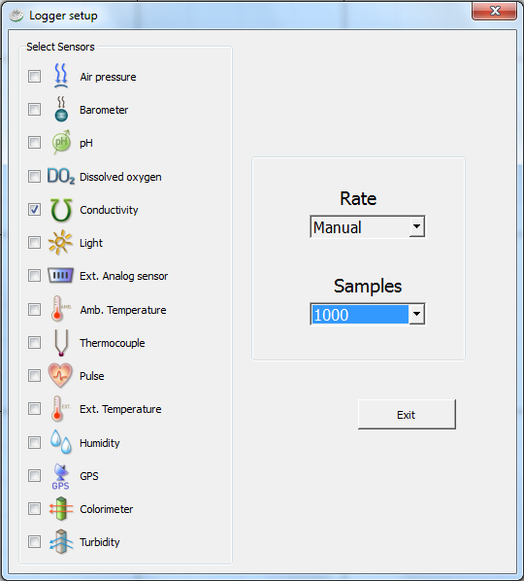
Liquid Conductivity
Measuring conductivity in saline water solutions
^{Using the Labdisc}
3
Click on to configure the Labdisc. Select pH in the “Logger Setup” window. Enter “Manual” for Rate.

Slide 11



Liquid Conductivity
Measuring conductivity in saline water solutions
^{Using the Labdisc}
4
Set the Labdisc display to show Bar Graph
Once you have finished the sensor configuration start measuring by clicking
Once you have finished measuring stop the Labdisc by clicking
5
6

Slide 12

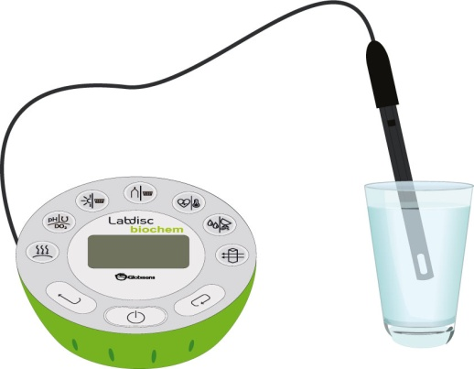
Liquid Conductivity
Measuring conductivity in saline water solutions
^{Experiment}
1
Turn on the Labdisc
Fill 500 ml of distilled water in the beaker and measure its conductivity (Sample 1) click on .
Mix 0.1 g of NaCl (Sample 2) until it dissolves completely using the stirrer bar and measure the conductivity
2
3

Slide 13
Liquid Conductivity
Measuring conductivity in saline water solutions
^{Experiment}
4
Repeat the previous step measuring saline water adding 0.05 g of salt each time. The five samples are showed in the following table:
Note: the molar concentration is equivalent to [mol/L]
Once you have finished, stop the Labdisc
Sample | NaCl [g] | Concentration [M]
1 | 0.00 | 0.0000
2 | 0.05 | 0.0017
3 | 0.10 | 0.0034
4 | 0.15 | 0.0052
5 | 0.20 | 0.0069
5

Slide 14
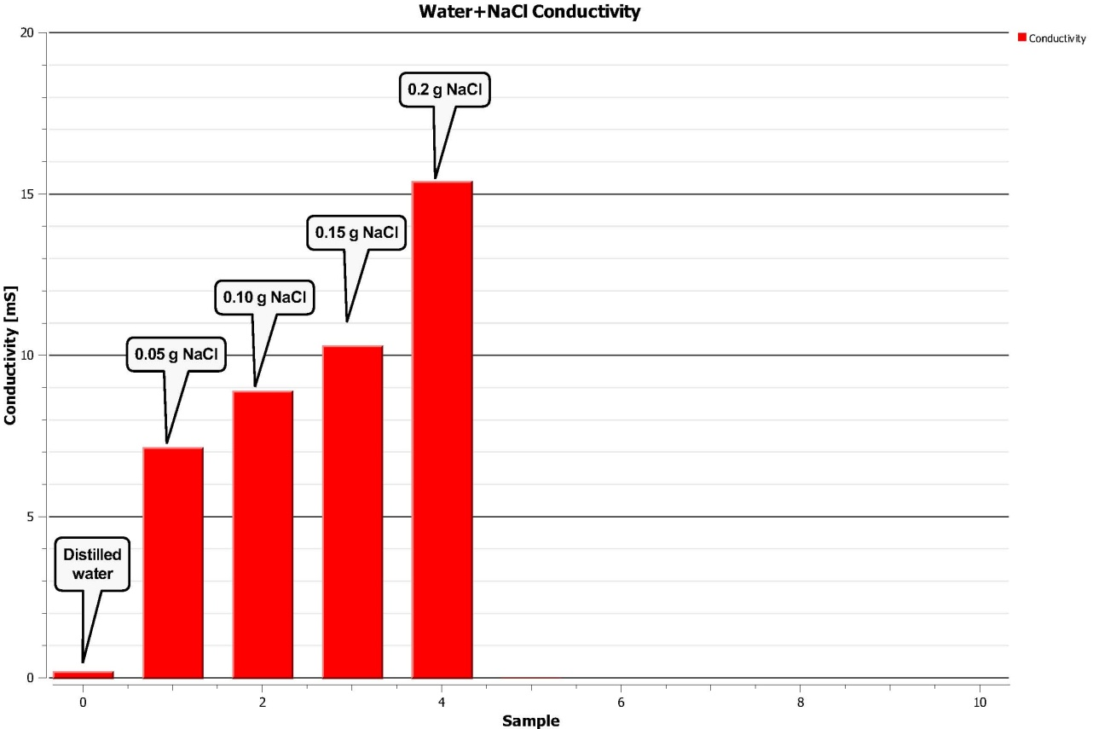
Liquid Conductivity
Measuring conductivity in saline water solutions
^{Experiment}
The graph below should be similar to the one the students came up with

Slide 15


Liquid Conductivity
Measuring conductivity in saline water solutions
^{Results and analysis}
1
Use the Annotation function to annotate the Bar Graph as shown above
Export the data to Excel clicking on . Save the data on your computer
Paste the concentration values from the previous table. Organize the data from the second sample to the last and calculate the molar concentration values in each case. Data should be organized as showed in the following table:
2
3
Sample | Conductivity [mS/cm] | Concentration [M] | Molar conductivity

Slide 16
Liquid Conductivity
Measuring conductivity in saline water solutions
^{Results and analysis}
4
Calculate the average molar conductivity from the four obtained values and interpret its meaning based on the units.
Create a line graph of conductivity as a function of concentration. To do this, first create a scatter plot and add a regressing line to the graph by right-clicking on the points and selecting “Add Trendline”. Select the linear regression type.
5

Slide 17

Liquid Conductivity
Measuring conductivity in saline water solutions
^{Results and analysis}
Was the hypothesis proved?
How did conductivity change with increasing salt concentration in the solution?
What was the conductivity value of pure distilled water? Did you expect that
value?
What are the Ʌ units of measurement?

Slide 18
Liquid Conductivity
Measuring conductivity in saline water solutions
^{Results and analysis}
The graph below should be similar to the one the students came up with:

Slide 19

Liquid Conductivity
Measuring conductivity in saline water solutions
^{Conclusion}
Why is saline solution conductive?
Students should point out that the salt dissociates into its Na⁺ and Cl⁻ ions when it dissolves in water allowing the transportation of charges in the presence of an electrical potential.
Why is conductivity made higher by increasing the amount of NaCl in the solution?
Students should indicate based on the theoretical framework that increasing sodium chloride in the solution produces an increment of dissolved charge carriers that facilitate the flow of electric current.

Slide 20
Liquid Conductivity
Measuring conductivity in saline water solutions
^{Conclusion}
How would you interpret molar conductivity?
Students should suggest that according to the units of measurement from this value, they are proportionaly constant, indicating the increased rate of the conductivity per unit of concentration in the solution.

Slide 21

Liquid Conductivity
Measuring conductivity in saline water solutions
Activities for further application
If you wanted to monitor the purity of water, would you use conductivity as an indicator? Explain.
Students might point out that the purity of water is given by the concentration of different types of dissolved solutes. Many of them are separated into ions, such as sodium chloride, so that the conductivity reports give us an approximate value of the concentration of dissolved solutes.
If you stir a volume of distilled water with your fingers, will the conductivity vary?
Students should suggest that the excretion of salts through the skin produces a little conductivity change in distilled water.

Slide 22


