Slide 1



Friction
Investigating static and kinetic friction of a body on different surfaces

Slide 2

^{Friction}
Investigating static and kinetic friction of a body on different surfaces
^{Objective}
The objective of this research is to study the behavior of friction force in a simple situation, observing quantitatively the difference between static and kinetic friction. Students will create a hypothesis and then test it using the Dymo Force sensor.

Slide 3

^{Friction}
Investigating static and kinetic friction of a body on different surfaces
^{Introduction and theory}
Interactions are a very important issue for physics. We constantly try to describe and explain the phenomenon of everyday life through scientific concepts and we live in a world where friction is part of every interaction. Energy is lost steadily through friction and the heat generated by it. One way to describe this phenomenon is through the force of friction that occurs when two bodies are in contact.
In what everyday life situations have you witnessed the phenomenon of friction?

Slide 4
^{Friction}
Investigating static and kinetic friction of a body on different surfaces
^{Introduction and theory}
What factors are necessary for friction to occur? Why?
What parameters must be met so that there is no friction?

Slide 5

^{Friction}
Investigating static and kinetic friction of a body on different surfaces
^{Introduction and theory}
Theoretical
The friction force occurs when two surfaces are in contact. This depends on the reaction of the surface, called normal force.
Normal (N) is the force of reaction of the surface with respect to the body, and going in a direction perpendicular to the surface already named. Moreover, the friction force is generally opposite to the direction of movement. Let’s see these directions and senses in a Free Body Diagram (DCL):
Normal
Friction force
Applied force
Weight

Slide 6
^{Friction}
Investigating static and kinetic friction of a body on different surfaces
^{Introduction and theory}
Friction can be static or kinetic. Kinetic happens when a body is moving, that is, its speed is nonzero. By contrast, static friction occurs when the velocity of a body is zero.
It has been found that after an object is moved, less force must be applied to continue the movement. This indicates that kinetic friction is always less than the maximum static friction.
Kinetic friction < maximum static friction force
This was discovered experimentally and you can check for yourself. When you move a heavy object it takes more force to start, but once the object is already in motion, the difficulty decreases.

Slide 7
^{Friction}
Investigating static and kinetic friction of a body on different surfaces
^{Introduction and theory}
For each material the friction is different. For example, on ice friction is small, whereas on asphalt friction is much higher. Thus, each surface is associated with a friction coefficient. There is a coefficient of kinetic friction and a static represented by the Greek letter .We place the subscript “k” for kinetic Kine, which means movement, and in the case of static an “s”. As seen above, we can say that for each material:
As we said in the beginning, the friction force depends on the normal force (N), and cannot be greater than this. So for this to happen, for both friction coefficients we have:

Slide 8
^{Friction}
Investigating static and kinetic friction of a body on different surfaces
^{Introduction and theory}
Static friction force: In this no movement is presented, and it holds that:
The term is less than, or equal results. This is because the static friction depends on the force being applied to the object, and its value will be the amount needed to maintain balance between the forces.
Kinetic friction force: motion is presented, and the relation with the normal force is an equality:
With the equality shown, it can be concluded that whenever one wants to theoretically calculate the force of kinetic friction of a body, one must calculate the value of the Normal force.

Slide 9
^{Friction}
Investigating static and kinetic friction of a body on different surfaces
^{Introduction and theory}
Now students are encouraged to propose a hypothesis to be tested with an experiment.
If you move a wooden block from rest through a rough surface, what magnitudes and physical characteristics define the minimum force that must be applied to start the movement? Is it different from the force you need to keep the object moving? Support your answer

Slide 10
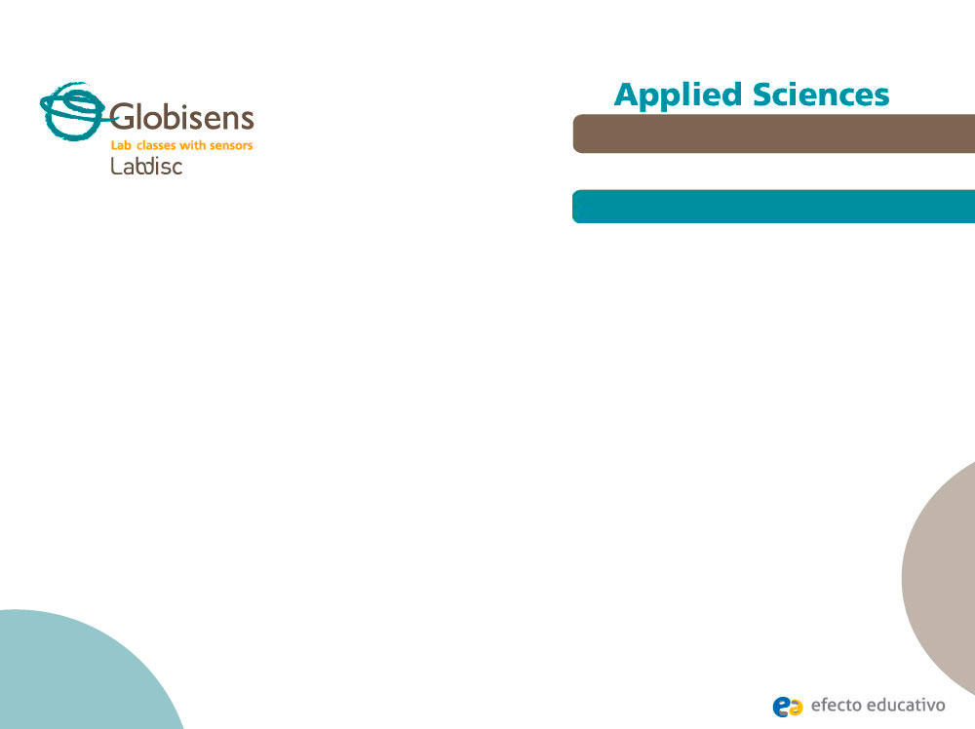
^{Friction}
Investigating static and kinetic friction of a body on different surfaces
^{Activity description}
Students will measure the force applied to move a wooden object on three different sandpapers. For one of the sandpapers, it will be moved with the initial weight of the object, and then they will add extra weight of 100g, 200g, and 300g.

Slide 11
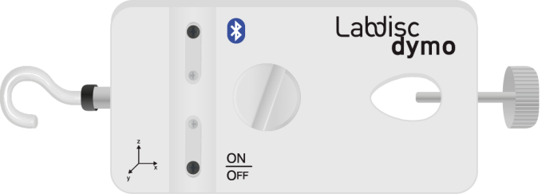

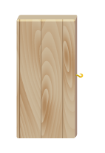
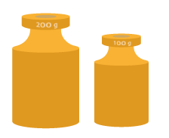
^{Friction}
Investigating static and kinetic friction of a body on different surfaces
^{Resources and materials}
Dymo Force sensor
USB cable
Piece of wood with hook
Weights 100g and 200g
String
Different Sandpapers (3)
Duct tape
4

Slide 12
^{Friction}
Investigating static and kinetic friction of a body on different surfaces
^{Using the Labdisc}
^{Labdisc configuration}
To collect force measurements with the Dymo force sensor, follow these steps:
Open the GlobiLab software and turn on the Labdisc.
Click on the Bluetooth icon in the bottom right corner of the GlobiLab screen. Select the Labdisc you are using currently. Once the Labdisc has been recognized by the software, the icon will change from a grey to blue color .
If you prefer a USB connection follow the previous instruction clicking on the USB icon. You will see the same color change when the Labdisc is recognized
.
1
2

Slide 13
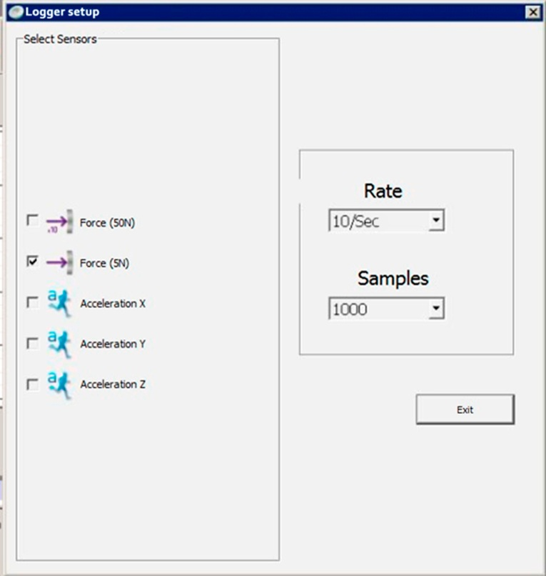
^{Friction}
Investigating static and kinetic friction of a body on different surfaces
^{Using the Labdisc}
Click to setup the Labdisc. Select Force (5N) in the "Logger Setup“ window. Enter a "10/sec“ sampling frequency.

Slide 14


^{Friction}
Investigating static and kinetic friction of a body on different surfaces
^{Using the Labdisc}
4
Once you have finished the sensor configuration start measuring by clicking .
Once you have finished measuring stop the Labdisc by clicking .
5

Slide 15
^{Friction}
Investigating static and kinetic friction of a body on different surfaces
^{Experiment}
Connect the Labdisc and the piece of wood via the string.
Attach the sandpaper on a flat surface using duct tape.
Measure the force it takes to move the wooden object along the sandpaper. The string should not be tight to start measuring.

Slide 16
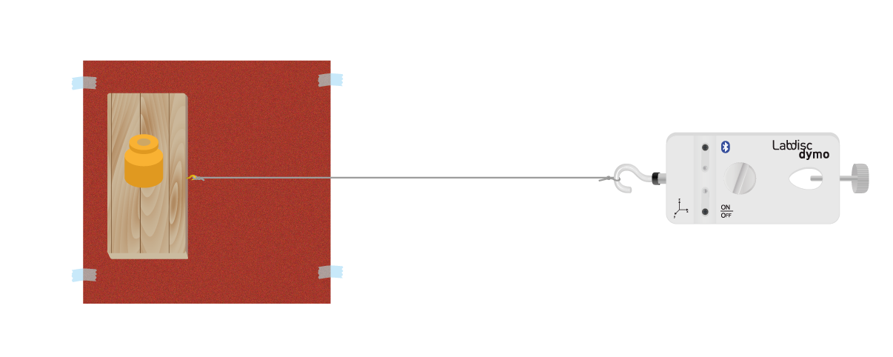
^{Friction}
Investigating static and kinetic friction of a body on different surfaces
^{Experiment}
Repeat the procedure for each of the sandpapers.
Then select one of the sandpapers and measure the force exerted to perform the movement with different weights. For this purpose use the weights of 100g, 200g and then both to reach 300g. Place the weights on the piece of wood.

Slide 17


^{Friction}
Investigating static and kinetic friction of a body on different surfaces
^{Results and analysis}
In each of the graphs indicate the deflection of the spring with the tool
, at the corresponding moments.
After this, ​​show the values of force at each moment of study by clicking on the curve with the tool .

Slide 18

^{Friction}
Investigating static and kinetic friction of a body on different surfaces
^{Results and analysis}
By observing each graph, where is the maximum friction force presented? To what type of friction does it correspond?
What is the reason that, at the end of the movement, the sensor still some force? What is the value of the friction force in each of these situations?
Does the movement presented by the object in each graph have constant speed? Support your answer.

Slide 19

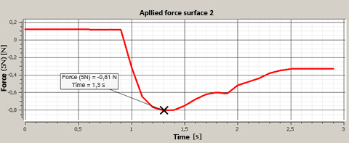
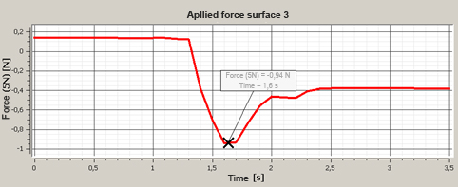
^{Friction}
Investigating static and kinetic friction of a body on different surfaces
^{Comparing different surfaces}
^{Results and analysis}
The graph below should be similar to the one the students came up with:

Slide 20
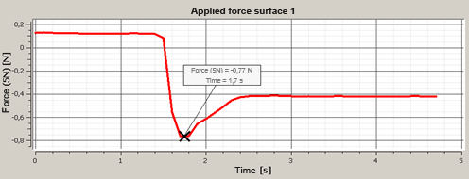
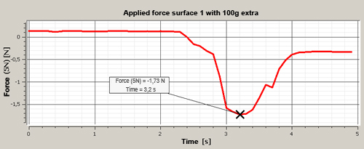
^{Friction}
Investigating static and kinetic friction of a body on different surfaces
^{Comparing different weights}
^{Results and analysis}
The graph below should be similar to the one the students came up with:

Slide 21
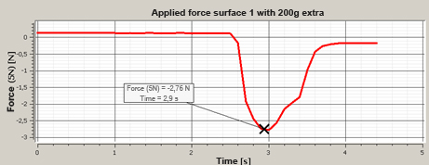
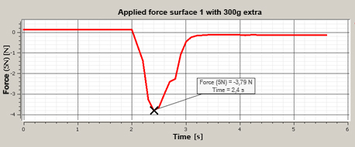
^{Friction}
Investigating static and kinetic friction of a body on different surfaces
^{Comparing different weights}
^{Results and analysis}
The graph below should be similar to the one the students came up with:

Slide 22

^{Friction}
Investigating static and kinetic friction of a body on different surfaces
^{Conclusions}
What is the coefficient of static friction on the surface where different weights were applied? Is this more or less than the other surfaces? Support your answer.
Students must identify the direct proportionality set to increase the weight of the object with the maximum static friction force, and thus identify that the coefficient of static friction corresponds to the constant of proportionality. Furthermore this ratio should be used to describe the behavior of the experiment and thus compare the values with the other surfaces.
When the piece of wood is moving, Is the force of kinetic friction greater, less than or equal to the force applied? Justify your answer using what you have observed in the experiment and graphs.
Students should identify that when accelerating the object, the applied force must necessarily be greater than the force of kinetic friction. This phenomenon of kinetic friction is important against the force of static friction, which has an equivalent to the magnitude of the applied force.

Slide 23

^{Friction}
Investigating static and kinetic friction of a body on different surfaces
Activities for further application
What were the conditions that allowed what you observed in this experience?
Students must identify the normal force and the type of material to be important factors in the experiment, framing the behavior observed in the graphs. Some students may present situations where the surfaces do not behave according to this theory, giving the opportunity to the teacher to deepen the content introducing the concept of viscous friction.
How can this knowledge be useful for sports like skiing? Conduct research to answer.
Students should research the coefficient of kinetic friction of snow on different surfaces. This is a basis for this sport where various researches are explored to create materials that allow the least possible friction, and thus gain greater speed.

Slide 24


