Slide 1


Earth green lungs
Measuring Carbon Dioxide level in different urban areas

Slide 2
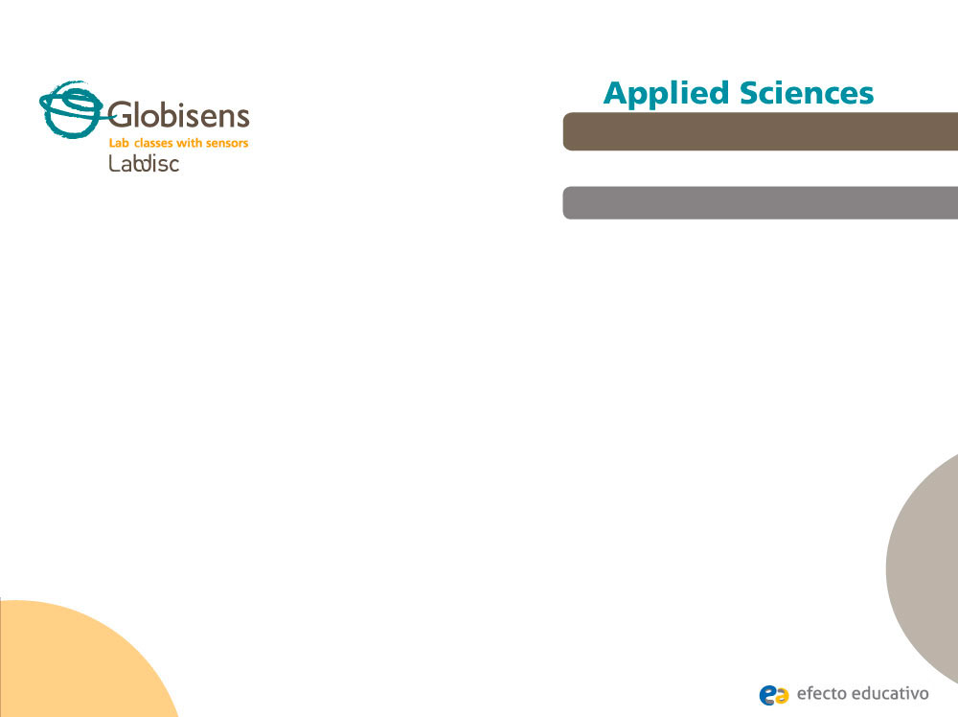
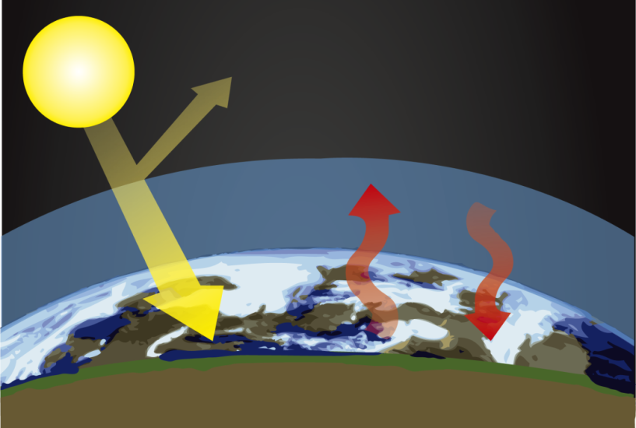
Earth green lungs
Measuring Carbon Dioxide level in different urban areas
^{Objective}
The purpose of this activity is to study the effect plants and parks have on reducing the CO₂ gas level in urban areas. Students will create a hypothesis which will be tested during an experiential activity using the Labdisc’s external CO₂ probe.

Slide 3

Earth green lungs
Measuring Carbon Dioxide level in different urban areas
^{Introduction and theory}
The aim of the introduction is to focus students on the lesson subject by refreshing acquired knowledge and asking questions which encourage research development. Key concepts from the theoretical framework, applied by the students during the lesson, are taught.
^{Introduction}
CO₂ is a colorless gas molecule consists of one carbon atom bonded with two oxygen atoms. This gas exists naturally in Earth's atmosphere at a concentration of about 0.04 percent (400 ppm). This gas together with Methane, Ozone, Nitrous Oxide and other greenhouse gasses act like a big blanket, preventing the sun heat from escaping to the atmosphere during night time – keeping the average temperature of the Earth.

Slide 4
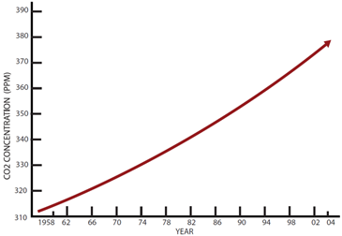
Earth green lungs
Measuring Carbon Dioxide level in different urban areas
^{Introduction and theory}
^{Theoretical}
However, CO₂ is also produced by combustion of wood and other organic materials and fossil fuels such as coal, peat, petroleum and natural gas. Human activities since the beginning of the Industrial Revolution have produced a 40% increase in the atmospheric concentration of CO₂, from 280 ppm in 1750 to 406 ppm in 2017. The rising of CO₂ concentration in the Atmosphere is the main reason for Global warming.

Slide 5
Earth green lungs
Measuring Carbon Dioxide level in different urban areas
^{Introduction and theory}
Global warming is a concept that refers to the rise in average global atmospheric and sea temperature.
As a result the Earth’s surface has continuously risen in temperature. This rise in average temperature reaches actually around 8°C. Some consequences of this are the melting of the poles, the rise in sea level and other problems like an increase in hurricane, tornado and storm frequency, hotter summers and colder and longer winter seasons.

Slide 6
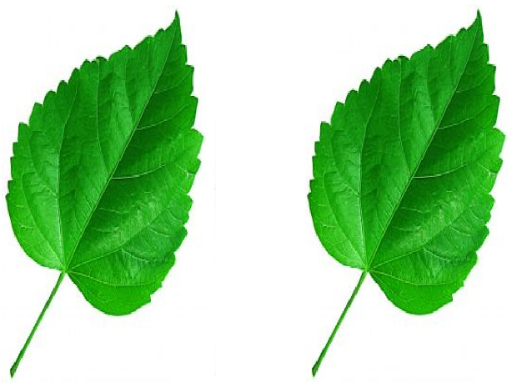
Earth green lungs
Measuring Carbon Dioxide level in different urban areas
^{Introduction and theory}
Yet - there is one main consumer of CO₂ on Earth; It’s the plants and forests around us, which during Photosynthesis – convert CO₂ molecules to Glucose and 6 Oxygen atoms:
Carbon
Dioxide
Luminic
Energy
Oxygen
Cellular respiration
Photosynthesis

Slide 7

Earth green lungs
Measuring Carbon Dioxide level in different urban areas
^{Introduction and theory}
At the end of this class you will be able to answer following question:
In which places in your city there is a higher concentration of CO₂?
Do you think there is a relationship between what happens in a greenhouse and
global warming?
What role have the parks and forests in fighting global warming?

Slide 8
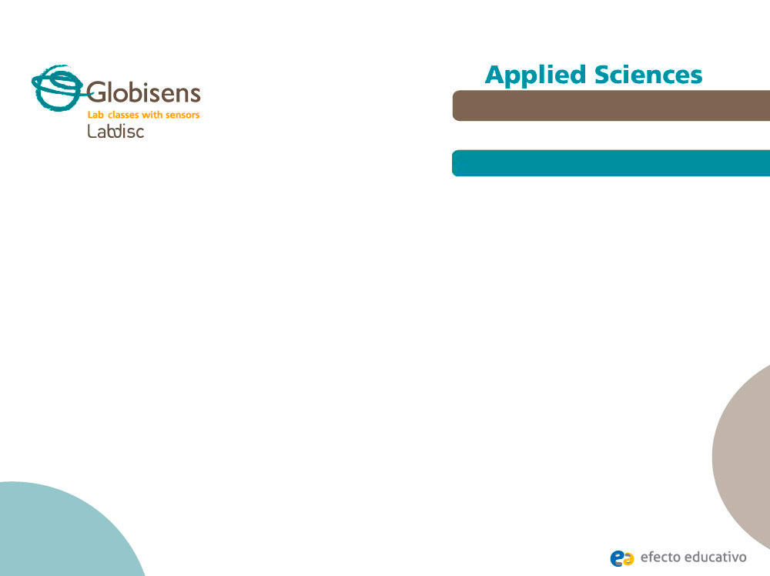
Earth green lungs
Measuring Carbon Dioxide level in different urban areas
^{Activity description}
Students will use the Labdisc external CO₂ probe to map the CO₂ level in their city. They will collect measurements, graph them on their computer, add a layer of CO₂ data over google map and draw conclusion on the level of CO₂ , parameters effecting high CO₂ level and ways to reduce it.

Slide 9
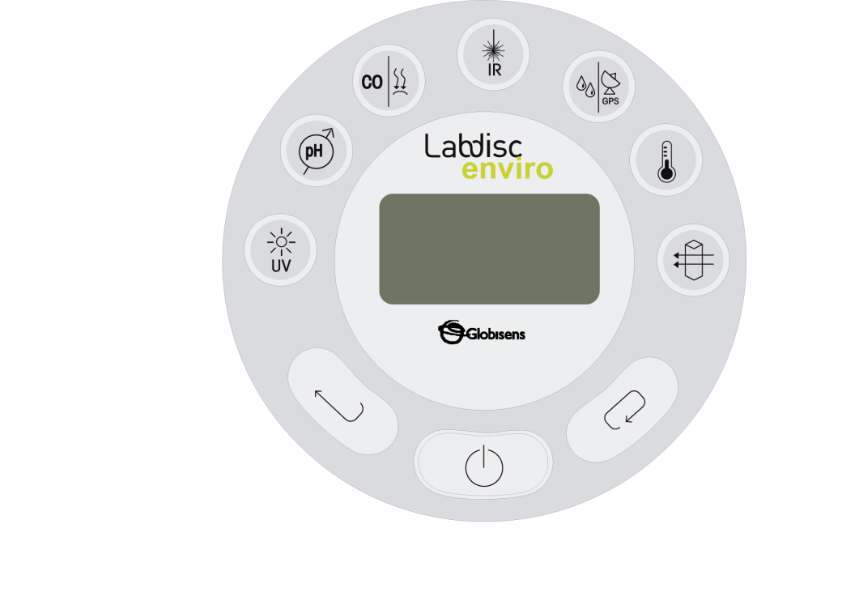
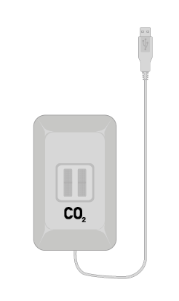
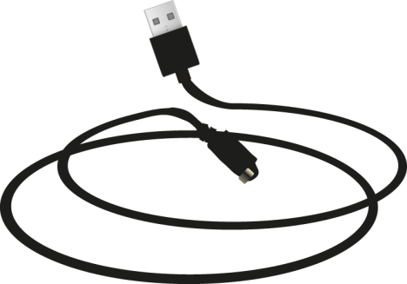
Earth green lungs
Measuring Carbon Dioxide level in different urban areas
^{Resources and materials}
Labdisc (any model)
External CO₂ probe
USB communication cable

Slide 10
Earth green lungs
Measuring Carbon Dioxide level in different urban areas
^{Using the Labdisc}
^{Using the probe}
To perform measurements with the carbon dioxide probe follow these steps:
Turn on the Labdisc.
Connect the CO₂ probe to the Labdisc universal output.
If this is the first time you are using the CO₂ probe, connect the Labdisc to its AC/DC adapter and let the probe warm-up over a 24-hour period in order to reach optimal accuracy.
1
2
3

Slide 11
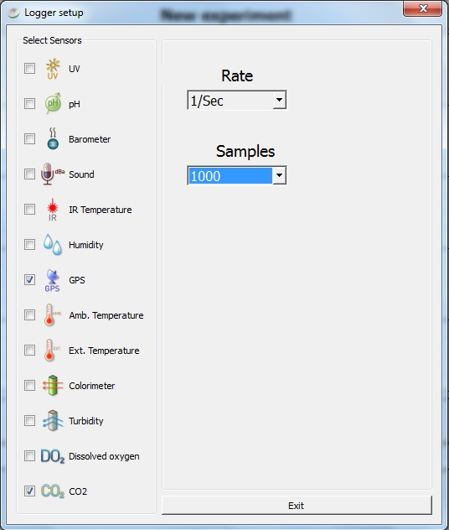
Earth green lungs
Measuring Carbon Dioxide level in different urban areas
^{Using the Labdisc}
4
Open the GlobiLab software and connect to the Labdisc through the USB cable, or via Bluetooth wireless communication.
Click to setup the Labdisc. Configure the sensor to measure CO₂ and GPS at a rate of one sample per second (1/s) while collecting a total of 1000 samples.
5

Slide 12


Earth green lungs
Measuring Carbon Dioxide level in different urban areas
^{Using the Labdisc}
6
Once you have completed the sensor setup, you may disconnect the Labdisc from the computer, turn it off and had to your trip in the neighborhood.
When you are ready to start recording – turn on the Labdisc and press .
To stop recording either wait for the Labdisc to collect 1000 samples, or press followed by immediate pressing .
The Labdisc keeps the SENSORS, SAMPLE-RATE and SAMPLES setup, and can store up to 127 recordings in its memory. Thus you may perform the same recording in different locations in your city.
7
8

Slide 13
Earth green lungs
Measuring Carbon Dioxide level in different urban areas
^{Experiment}
1
Place the Labdisc in a back pack with the CO₂ probe sticking out. Go to a nearby forest or park. Walk into a woody area and start recording. Walk from this point to a close by urban street. Stop recording after one or two minutes from reaching the street.
Perform another recording in a car or on your bicycle. Again place the Labdisc in a back pack with the CO₂ probe sticking out. Start recording and drive from a park to a busy road or highway. You don’t need to drive on the highway, but just get very close to it.
Check accumulation of CO₂ in your classroom. Make sure there are at least 20 students in the classroom. Start recording in the morning after the classroom was ventilated (windows were opened). Close all windows and record the full 1000 sampling points (about 20 minutes).
2
3

Slide 14




Earth green lungs
Measuring Carbon Dioxide level in different urban areas
^{Results and analysis}
1
Open the GlobiLab software. Connect the Labdisc and use the download button to download each of the 3 recordings.
For each recording observe the change in the CO₂ level. Use the markers to mark the minimum and maximum of the CO₂ graph. Get the rate of CO₂ increase by using the
linear regression button from Globilab function menu.
You may annotate the graph with text and photos using the Annotation button .
For the trip you’ve made walking or driving from the park – use the map view to see your trip as a layer of colors over Google Map and observe the change of CO₂ using the color legend to the right of the map.
2
3
4

Slide 15

Earth green lungs
Measuring Carbon Dioxide level in different urban areas
^{Results and analysis}
Where did you find higher CO₂ level? In the park? or at the busy street ?
What was the CO₂ source in the two outdoor experiments? and what was the CO₂ sink (consumer)?
At what rate did the CO₂ level rise in the closed classroom? How can you decrease the level of CO₂ in your classroom?

Slide 16
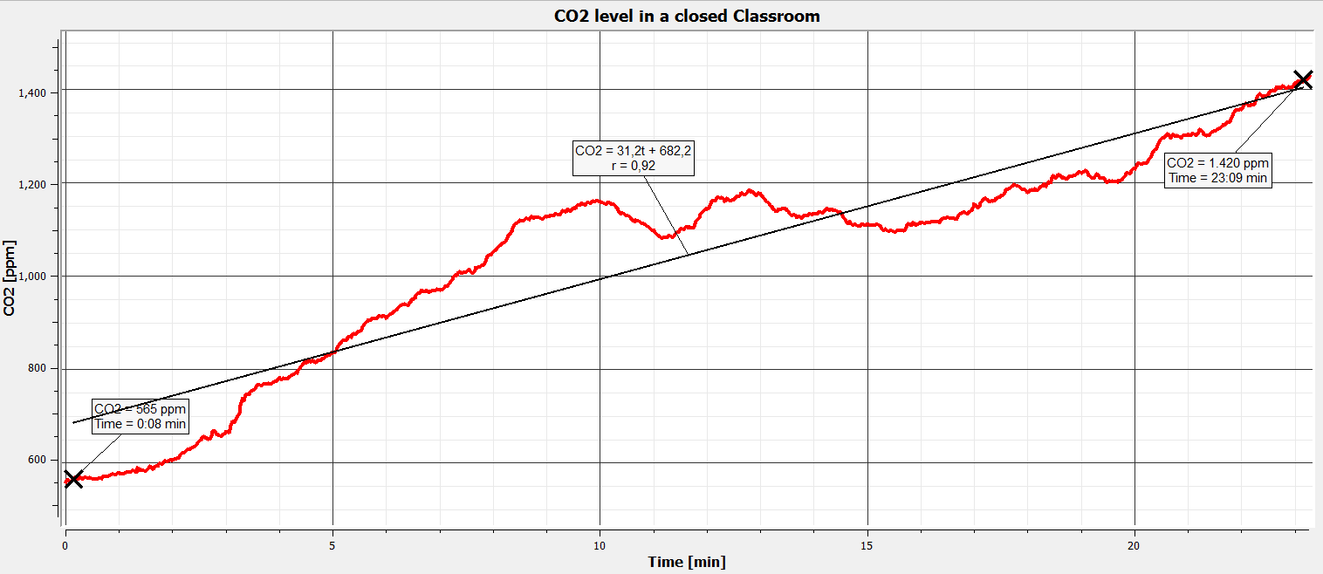
Earth green lungs
Measuring Carbon Dioxide level in different urban areas
^{Results and analysis}
When recording in a closed classroom – you should get a graph similar to the below:

Slide 17
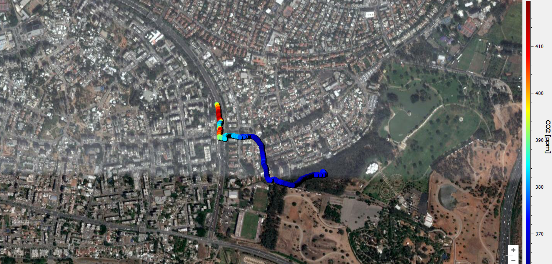
Earth green lungs
Measuring Carbon Dioxide level in different urban areas
^{Results and analysis}
When walking from the park to a street – you should get data similar to the below:
420ppm CO₂
in a near by street
360ppm CO₂
in the small forest

Slide 18
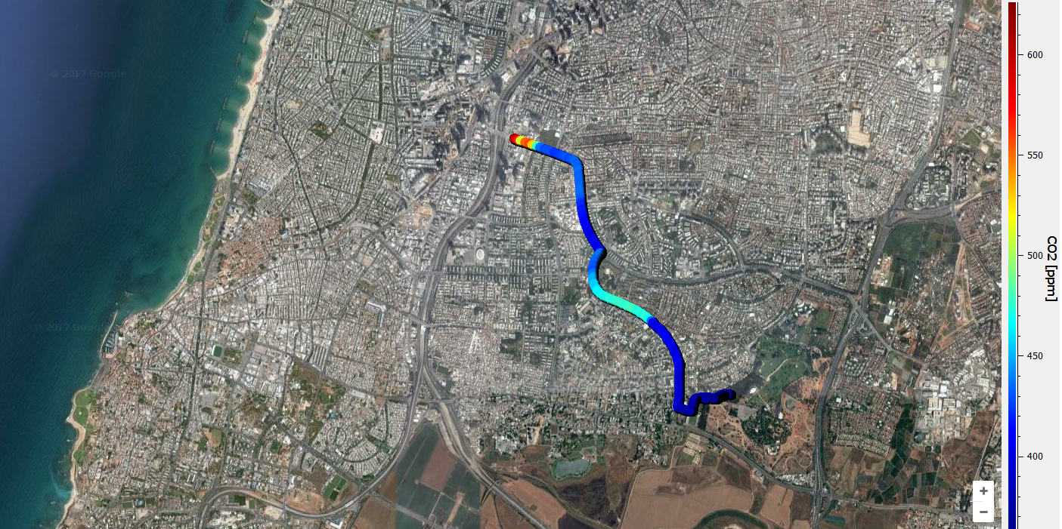
Earth green lungs
Measuring Carbon Dioxide level in different urban areas
^{Results and analysis}
When driving from a park to a highway – you should get data similar to the below:
620ppm CO₂
Close to the highway
6 lane
highway
360ppm CO₂
in the small forest

Slide 19
Earth green lungs
Measuring Carbon Dioxide level in different urban areas
^{Conclusions}
How can forests helps us fighting global warming?
Students should make the connection between plants and trees consuming CO₂ as part of Photosynthesis, and the reduction of CO₂ level in our atmosphere. A reduction which leads to more heat being able to escape the Earth surface – reducing global warming.
How do you expect the level of CO₂ to vary in the park on a sunny day compared to a cloudy day?
It is advisable to measure CO₂ level in the park on cloudy days (or at night), and compare them to measurements done on sunny days. Student should be able to point out that Photosynthesis requires sunlight, and as such - there will be higher rate of CO₂ consumption on sunny days – translating to lower CO₂ reading during these days.

Slide 20

Earth green lungs
Measuring Carbon Dioxide level in different urban areas
Activistas foro fuerte aplicación
The Amazon forest in Brazil is the largest forest in the world. Since 1970 this forest shrinked in 20% due to deforestation. What effect does it have on global warming?
Students should learn the term “green lungs” which refers to forests and parks and understand the bad effect of deforestation on reducing the effectiveness of these lungs in the production of oxygen and in protecting us against global warming.
S
Repeat the experiment recording the sound level sensor in the Labdisc, together with a GPS to create a noise level map of your city.
z
Students should design experiments where they will record both Sound level and GPS position in different section of the city, producing valuable municipal data on the noise level measured in residential areas on different days and different times of day.

Slide 21


